Slide 1
Patterns in the Periodic Table
Atomic Radius, Ionisation Energy and Electronegativity

Slide 2
Learning Objectives
Define the terms ionisation energy and electronegativity.
Describe and explain the trends in first ionisation energy, atomic radius, valency & electronegativity in the periodic table, with reference to groups 1, 2, 13 – 18 and periods
1 – 3.

Slide 3
Atomic Radius
Notes:
Teacher notes
In ‘Slide Show’ mode, click the name of a section to jump straight to that slide.

Slide 4



What is atomic radius?
The atomic radius of an element is difficult to precisely define because of the uncertainty over the size of the electron cloud. Several definitions are used.
One definition is half the shortest internuclear distance found in the structure of the element.
For non-metallic elements, the covalent radius is often used as the atomic radius. This is half the internuclear distance between two identical atoms in a single covalent bond.
covalent radius
Notes:
Teacher notes
Atomic radius is a very difficult quantity to measure directly because the electron cloud is not fixed in shape and size. Covalent or metallic radii are more commonly used and are sometimes referred to as the atomic radius. However, these radii also vary in different circumstances. A particular bond will have a slightly different length in different compounds containing that bond, due to the effect of the surrounding atoms. One way in which covalent radii can be determined is to measure the bond length in a variety of different compounds and compare the values. This introduces a further problem because covalent bonds in different compounds will have different degrees of ionic character. Ionic radius varies with the coordination number and spin state of the ion. An alternative way to determine atomic radii is to calculate them mathematically. This gives slightly different values to those obtained by observation.
In this presentation, atomic radii used are calculated values. Data from www.webelements.com.

Slide 5

More on atomic radius
For non-bonded adjacent atoms (e.g. in a covalent crystal of a non-metallic element), the van der Waals radius is used as a value for atomic radius. This is half the shortest internuclear distance between two similar non-bonded atoms.
van der Waals radius
For metallic elements, the metallic radius is often used as the atomic radius. This is half the shortest internuclear distance between two adjacent atoms in a metallic bond.

Slide 6

Trend in atomic radius

Slide 7
Explaining the trend in atomic radius
The atomic radius of the
elements increases down
group 2 from beryllium to barium.
Atomic
radius
(nm)
Element
The number of protons increases down the group; however, so does the number of shielding electrons. Effective nuclear charge therefore remains approximately constant.
beryllium
0.112
magnesium
0.145
calcium
0.194
strontium
0.219
barium
0.253
The increase in radius is due to higher principle energy levels being filled, whose orbitals are located further from the nucleus.
Notes:
Teacher notes
See the ‘Trends in Period 3’ presentation for more information about atomic radius, shielding and effective nuclear charge.

Slide 8
Trends in atomic radius in period 3

Slide 9
Trends in atomic radius in period 3
The atomic radius of the elements across period 3 decreases.
Atomic radius (nm)
Element
Na
0.190
This might seem counter-intuitive, because as the numbers of sub-atomic particles increase, the radius might be expected to also increase.
Mg
0.145
Al
0.118
Si
0.111
P
0.098
However, more than 99% of the atom is empty space – the nucleus and electrons themselves occupy a tiny volume of the atom.
S
0.088
Cl
0.079
Ar
0.071
Notes:
Teacher notes
Observed values for covalent radii follow the same trend as the calculated values given here, apart from the value for argon. The covalent radius is half the covalent bond length. Argon does not normally form covalent bonds (it is monatomic) therefore either no value is given for argon or the value is anomalously high.
Covalent bond lengths are:
Na 0.166nm
Mg 0.141nm
Al 0.121nm
Si 0.111nm
P 0.107nm
S 0.105nm
Cl 0.102nm
Ar 0.106nm

Slide 10
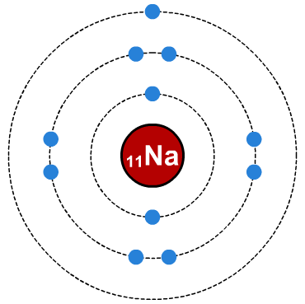
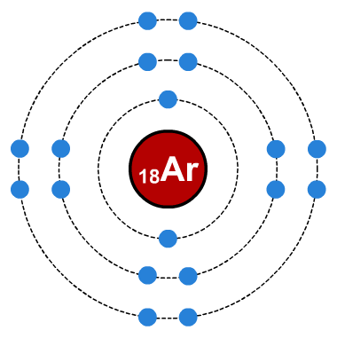
Increase in proton number
The number of protons in the nucleus of the atoms increases across period 3.
Element
₁₁Na
₁₂Mg
₁₃Al
₁₄Si
₁₅P
₁₆S
₁₇Cl
₁₈Ar
proton number
This increase in the number of protons increases the nuclear charge of the atoms. The nucleus has stronger attraction for the electrons, pulling them in closer and so the atomic radius decreases across the period.
increased nuclear charge pulls electrons closer

Slide 11
What is shielding?
Notes:
Teacher notes
This animation only describes the shielding effect. In the final stage, each atom is portrayed as being of a similar size across the period because there is very little variation in shielding. It may be worth reminding students that, when the increase in nuclear charge is taken into account, atomic radius decreases across the period.

Slide 12
Explaining atomic radius in period 3
Proton number increases across period 3, but shielding remains approximately constant.
Atomic radius (nm)
Proton number
Element
Na
11
0.190
Mg
12
0.145
This causes an increase in effective nuclear charge, leading to a greater attraction between the nucleus and the outermost electrons.
Al
13
0.118
Si
14
0.111
P
15
0.098
S
16
0.088
Cl
17
0.079
This pulls these electrons closer to the nucleus and results in a smaller radius.
Ar
18
0.071

Slide 13
Atomic radius in period 3

Slide 14
Atomic radius: true or false?

Slide 15
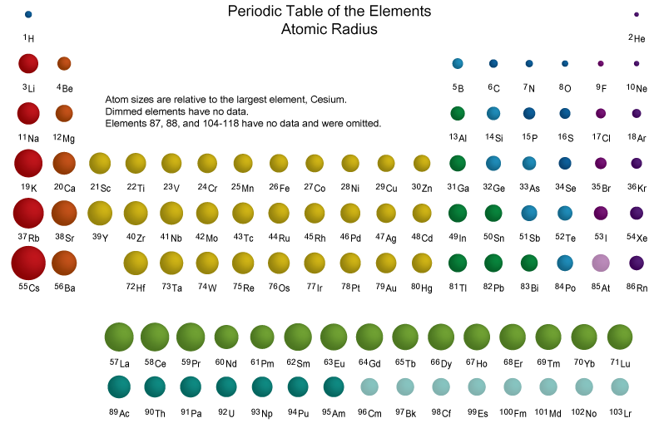
Atomic radius across the Periodic Table

Slide 16
Ionisation Energy
Notes:
Teacher notes
In ‘Slide Show’ mode, click the name of a section to jump straight to that slide.

Slide 17
What is first ionization energy?
Ionization is a process in which atoms lose or gain electrons and become ions.
The first ionization energy of an element is the energy required to remove one mole of electrons from one mole of gaseous atoms to form one mole of ions.
M(g) → M⁺(g) + e⁻
The first ionization energy is therefore a measure of the strength of the attraction between the outermost electrons and the nucleus.
Notes:
Teacher notes
Technically, the first ionization energy is the energy required to remove one mole of electrons from one mole of gaseous atoms. Successive ionization energies are those required to remove further moles of electrons.
Students could be made aware that, at this level, ionization generally refers to the removal of electrons. The gain of electrons is generally discussed in terms of ‘electron affinity’.

Slide 18
Trend in first ionization energy

Slide 19
First ionization energies in group 2

Slide 20
First ionization energy of group 2 metals

Slide 21
Plot of the first ionization energies

Slide 22
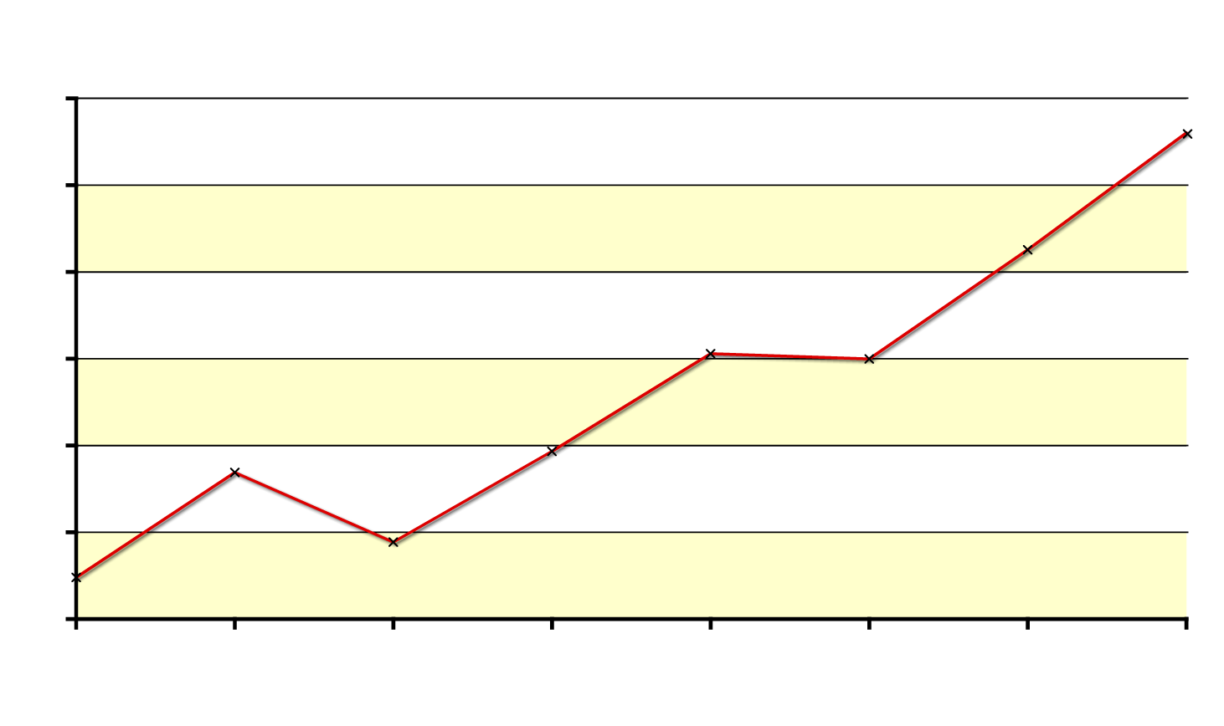
General trend in first ionization energy
There is a general increase in the first ionization energies across period 3.
1600
1400
1200
ionization energy (kJ mol⁻¹)
1000
Across period 3, the proton number increases but the amount of shielding does not change
800
600
400
Na
Mg
Al
Si
P
S
Cl
Ar
element
significantly.
The effective nuclear charge therefore increases.
The greater attraction between the nucleus and the outermost electrons means that more energy is required to remove an electron.

Slide 23
Trend in first ionization energy: exceptions
There are two exceptions to the general trend in first ionization energy: both aluminium and sulfur have lower ionization energies than might be expected.
1600
1400
lower ionization energies than expected
1200
ionization energy (kJ mol⁻¹)
1000
800
600
400
Na
Mg
Al
Si
P
S
Cl
Ar
element

Slide 24
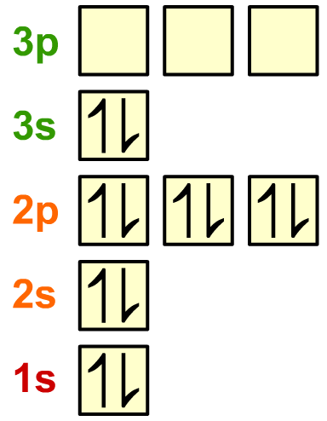
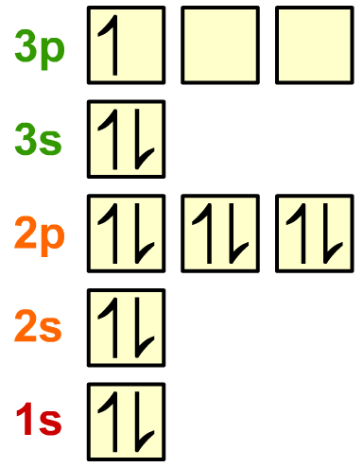
First ionization energy of Al vs. Mg
The first ionization energy of aluminium is less than that of magnesium, even though aluminium has a higher nuclear charge.
The electron removed when aluminium is ionized is in a 3p sub-level, which is higher in energy than the 3s electron removed when magnesium is ionized. Removing an electron from a higher energy orbital requires less energy.
magnesium
aluminium
Notes:
Teacher notes
See the ‘Electron Arrangement’ presentation for more information about energy levels and electron orbitals.

Slide 25
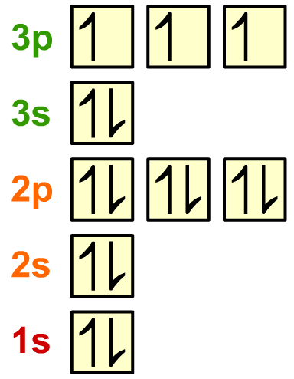

First ionization energy of S vs. P
The first ionization energy of sulfur is less than that of phosphorus, even though sulfur has a higher nuclear charge.
The highest energy electron in both phosphorus and sulfur is in the 3p sub-level. However, in sulfur this electron is paired, while in phosphorus each 3p orbital is singly occupied. Mutual repulsion between paired electrons means less energy is required to remove one of them.
phosphorus
sulfur
Notes:
Teacher notes
See the ‘Electron Arrangement’ presentation for more information about energy levels and electron orbitals.

Slide 26
Ionization energy in period 3

Slide 27
Electronegativity
Notes:
Teacher notes
In ‘Slide Show’ mode, click the name of a section to jump straight to that slide.

Slide 28
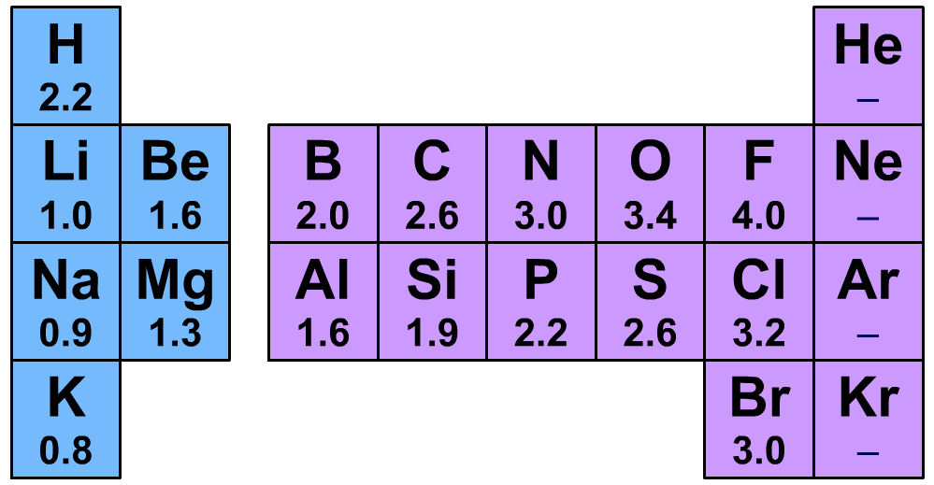
What is electronegativity?
In a covalent bond between two different elements, the electron density is not shared equally.
This is because different elements have differing abilities to attract the bonding electron pair. This ability is called an element’s electronegativity.
Electronegativity values for some common elements. Values given here are measured on the Pauling scale.
Notes:
Teacher notes
Elements in group 8 do not commonly form bonds so electronegativity values have not been measured.
Electronegativity was first proposed in 1932 by the American chemist Linus Pauling (1904-1994). It is after him that the scale used here for measuring electronegativity is named. While the Pauling scale is the most common, there are other measures of electronegativity in use.

Slide 29
What is electronegativity?
Electronegativity is often defined poorly in test questions!
Electronegativity is:
the ability of an atom
in a molecule
to attract electrons
in a covalent bond
towards itself.
Notes:
Teacher notes
Elements in group 8 do not commonly form bonds so electronegativity values have not been measured.
Electronegativity was first proposed in 1932 by the American chemist Linus Pauling (1904-1994). It is after him that the scale used here for measuring electronegativity is named. While the Pauling scale is the most common, there are other measures of electronegativity in use.

Slide 30
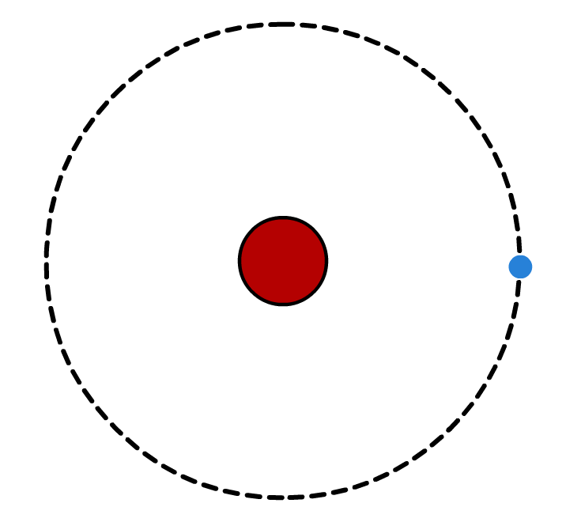
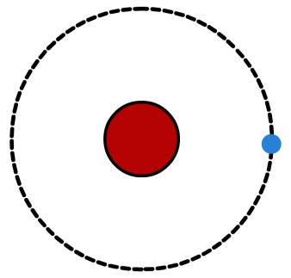
Electronegativity and atomic radius
The electronegativity of an element depends on a combination of two factors:
1. Atomic radius
As radius of an atom increases, the bonding pair of electrons become further from the nucleus. They are therefore less attracted to the positive charge of the nucleus, resulting in a lower electronegativity.
higher electronegativity
lower electronegativity
Notes:
Teacher notes
See the ‘Trends in Period 3’ presentation for more information about atomic radius.
Note that the inner electron levels have not been included in the diagram.

Slide 31
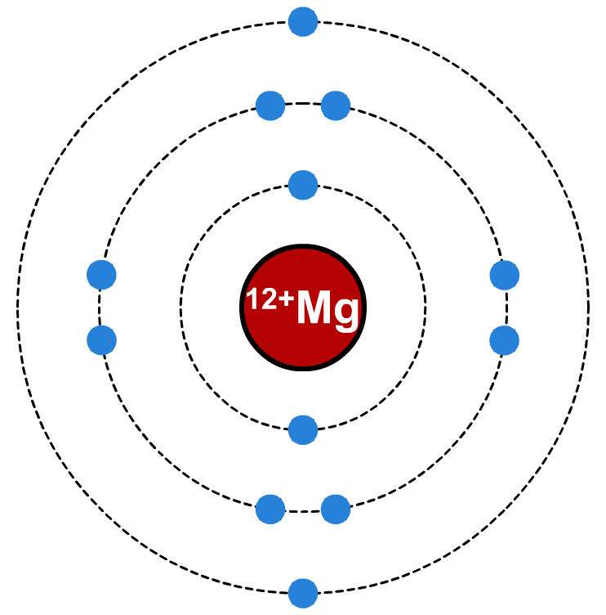
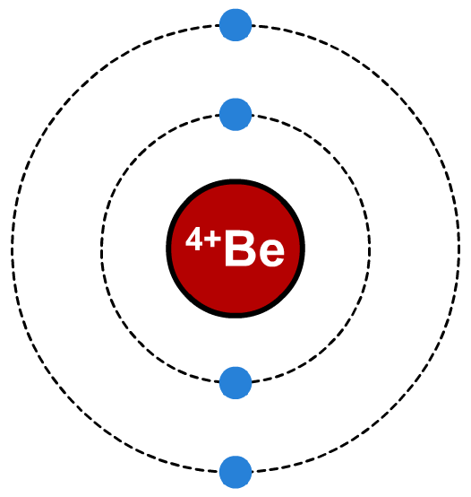
Electronegativity, protons and shielding
2. The number of unshielded protons
The greater the number of protons in a nucleus, the greater the attraction to the electrons in the covalent bond, resulting in higher electronegativity.
However, full energy levels of electrons shield the electrons in the bond from the increased attraction of the greater nuclear charge, thus reducing electronegativity.
greater nuclear charge increases electronegativity…
…but extra shell of electrons increases shielding.
Notes:
Teacher notes
See the ‘Trends in Period 3’ presentation for more information about shielding.

Slide 32
Electronegativity trends: across a period
Electronegativity increases across a period because:
1. The atomic radius decreases.
2. The charge on the nucleus increases without significant extra shielding. New electrons do not contribute much to shielding because they are added to the same principal energy level across the period.
Notes:
Teacher notes
Fluorine has, with a Pauling electronegativity value of 4.0, the highest electronegativity of all the elements.

Slide 33
Electronegativity trends: down a group
Electronegativity decreases down a group because:
1. The atomic radius increases.
2. Although the charge on the nucleus increases, shielding also increases significantly. This is because electrons added down the group fill new principal energy levels.

Slide 34
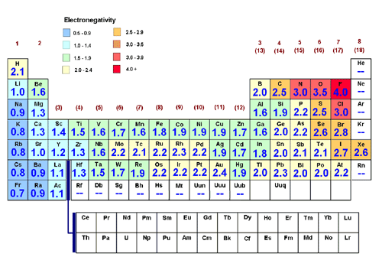
Electronegativity and the Periodic Table

Slide 35
Further Reading
References:
Pearson Chapter 3
Lucarelli Chapter 9
Questions:
Lucarelli Set 15
STAWA Set 11

